Slide 1
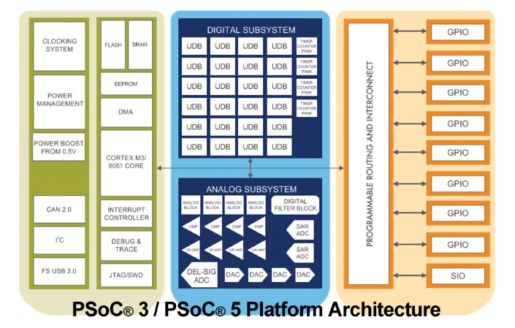
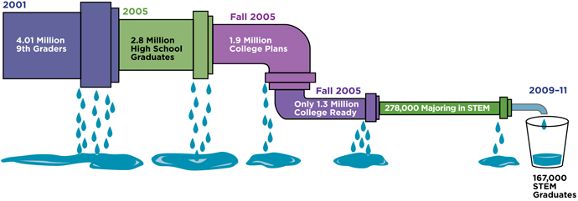
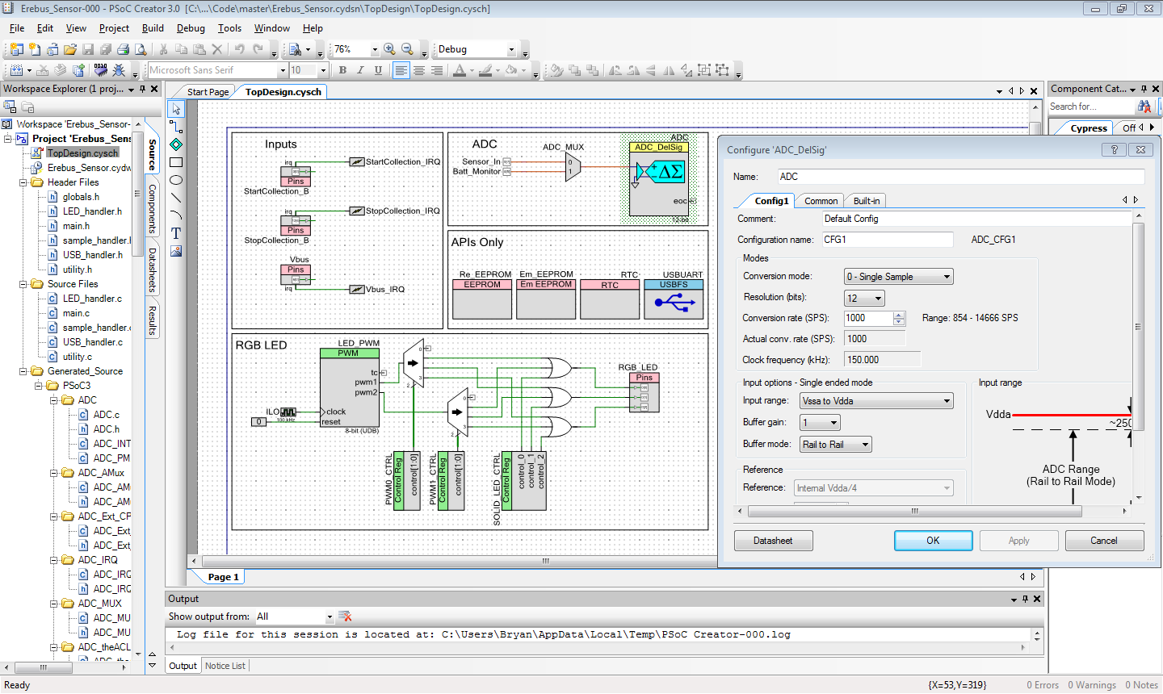

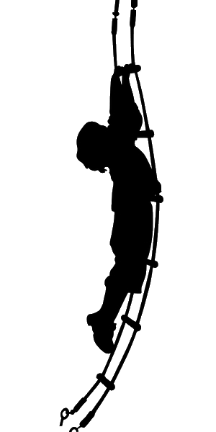
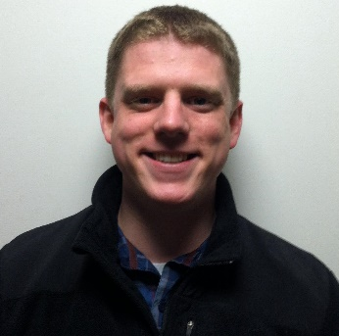

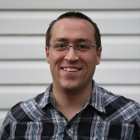

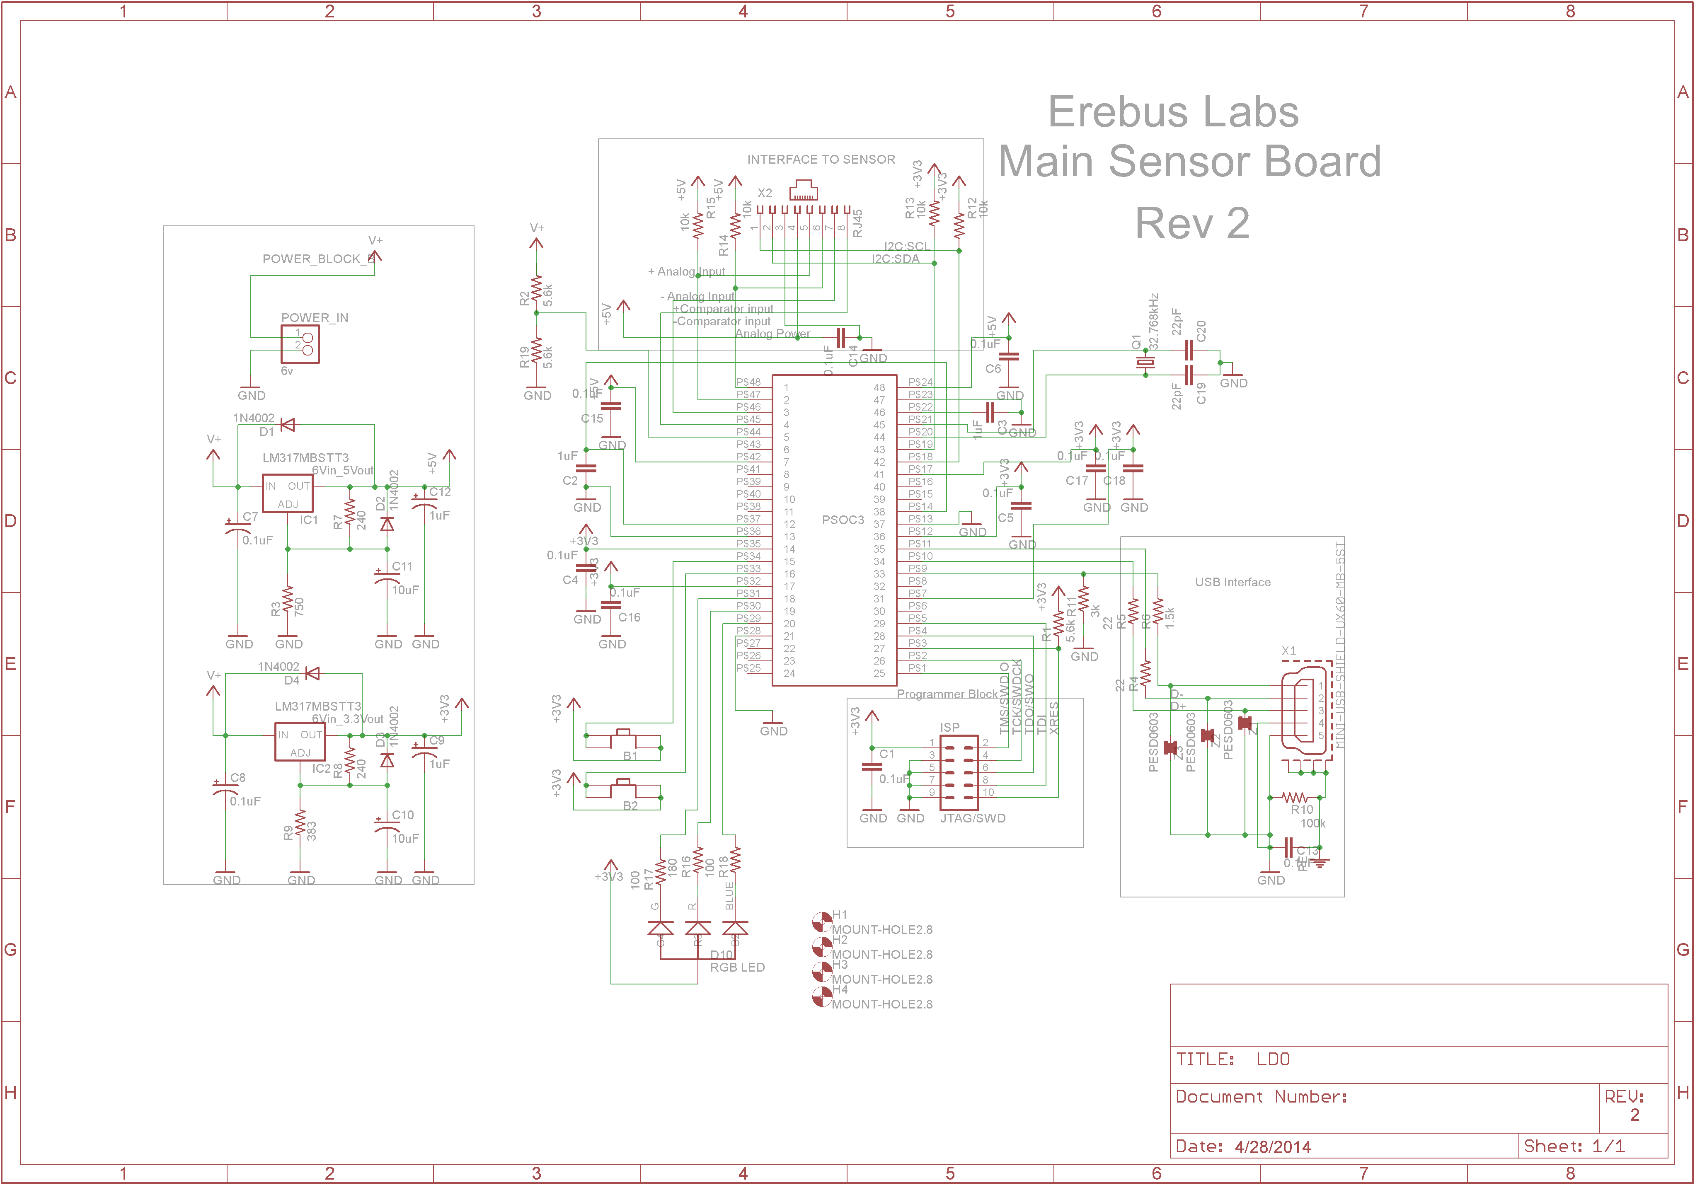
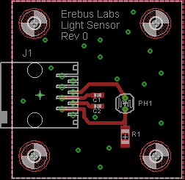

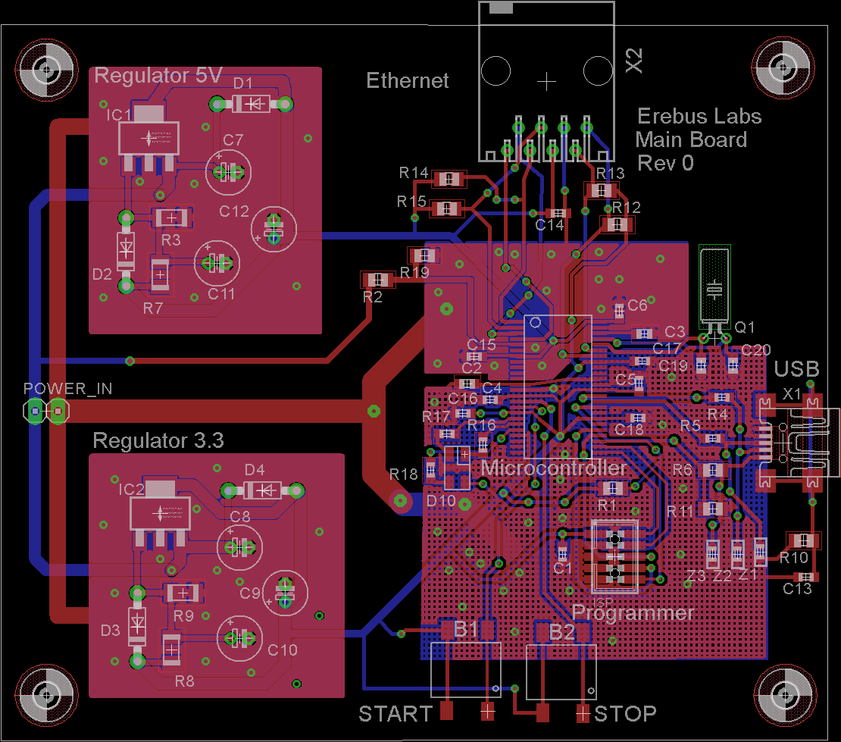
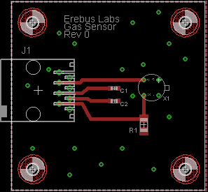
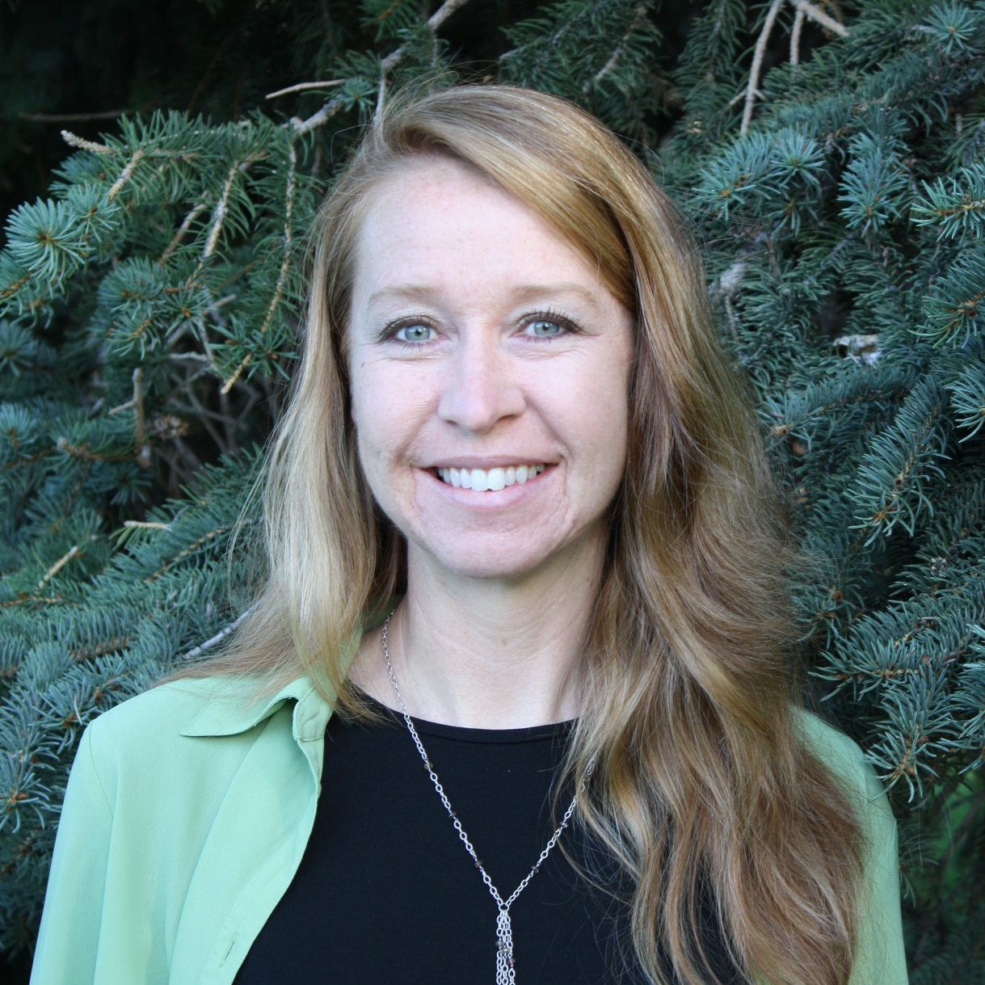
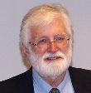
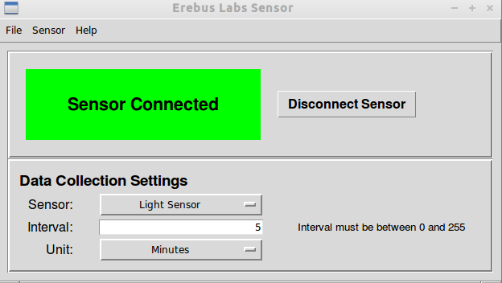


Erebus Labs STEM Sensor
Overview
Implementation
Current educational curriculum in the US lacks a focus on Science, Technology, Engineering, and Mathematics (commonly referred to as STEM). Resistance to STEM begins in primary education classrooms where 50% of 8th graders have a hostile attitude towards math and science¹. Furthermore, according to the United States department of education, only %16 of American high school seniors are proficient in mathematics and interested in a STEM career².
For the processor, we selected the Cypress PSoC 3. We chose this chip due to its feature set and flexibility. The PSoC 3 architecture utilizes programmable interconnects which allow many chip functions to be routed to a desired pin; it also includes Universal Digital Blocks (UDBs) which facilitate custom hardware designs such as a full speed USB controller.
The STEM pipeline problem^{3,4}
Objective
Our goal was to create a device that would allow students, or anyone who is interested, to easily measure the world around them. Getting kids interested in the ideas behind science and engineering is the first step to getting them interested in a STEM career later. We wanted to make data collection as plug-and-play as possible for simplicity while still allowing access to internal hardware and software for those who want to dig a little deeper.
Well documented APIs in PSoC Creator, the software which is used to program the PSoC 3, enabled rapid design and development by allowing us to make high level function calls without the requirement of low level register reading and writing to implement firmware functionality.
“50% of 8th graders have a hostile attitude towards math & science”
PSoC Creator Software
The Team
Our board design was done using the free version of CadSoft’s Eagle PCB layout software. Additionally, the PSoC Creator software is free to download with no limits. This use of free software for all development stages supports the sponsors’ goal of an open and accessible project.
Scott Lawson
Computer Engineering
Maxwell Cope
Electrical Engineering
Final Result
Bryan Button
Electrical Engineering
Chris Clary
Electrical Engineering
Our final implementation consists of two parts; a base station and an individual sensor module. This modular approach allows for more flexibility in the future. For the initial build we chose to include light and low-oxygen sensor modules.
References
Mike Borowczak, Ph.D. - Sponsor
Data Analytics Engineer @ SolidFire
Founder @ ErebusLabs
The base station itself is simple to operate. It has a single RGB LED to indicate system state, and two buttons that start or stop sampling.
Light Sensor
www.becpdx.org/nem/stemconnect.aspx
www.ed.gov/stem
Image courtesy of http://www.businessandeducation.org/supporting-stem-pipeline
Data source: NCES Digest of Education Statistics; Science & Engineering Indicators 2008
Andrea Burrows - Sponsor
Assistant Professor of Secondary Education
University of Wyoming
Low Oxygen Sensor
Using a GUI developed by our team, users are able to configure sample rate, download data, and view any errors detected in the system.
Base Station Schematic
James E. Morris - Advisor
Professor of Electrical and Computer Engineering
Portland State University
Base Station Board
Department of Electrical and Computer Engineering

